Slide 1













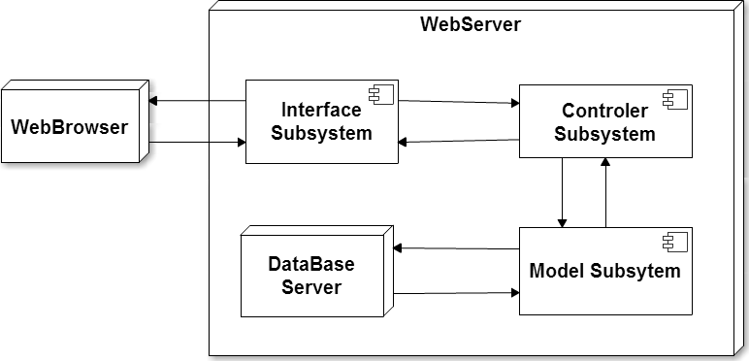
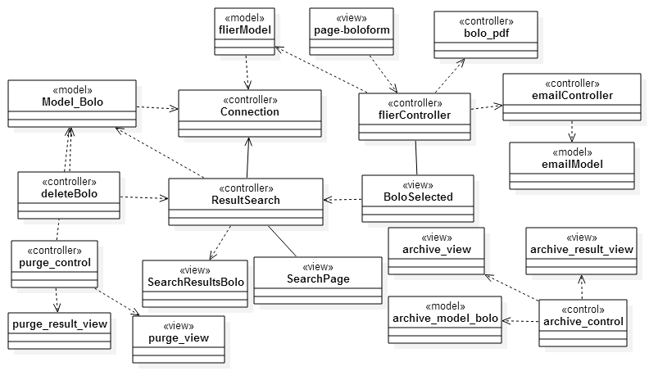
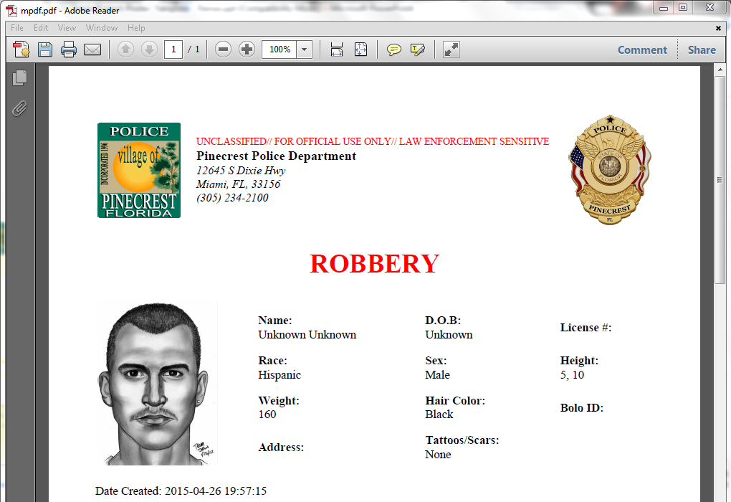
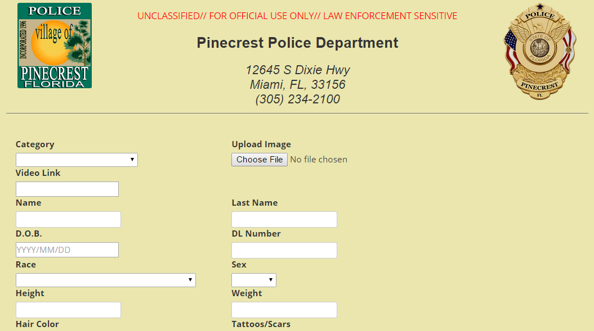
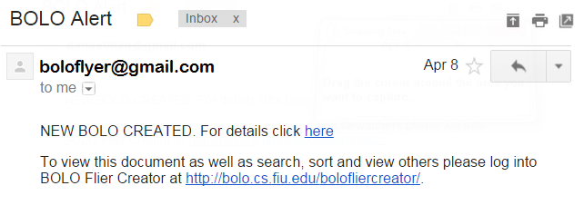
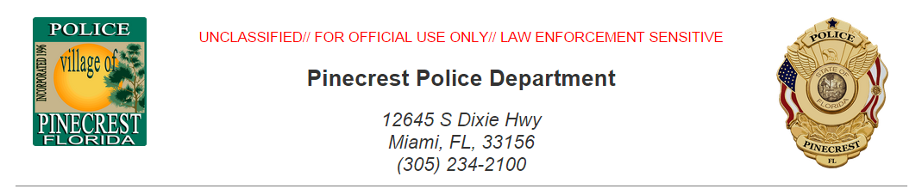

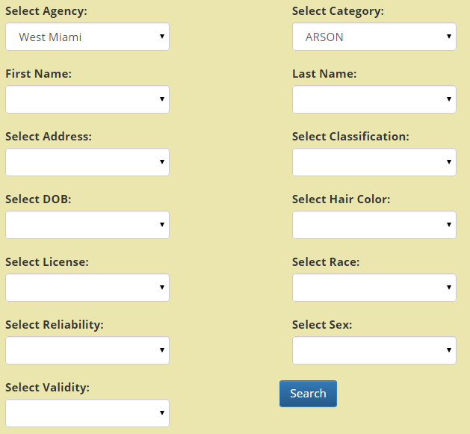
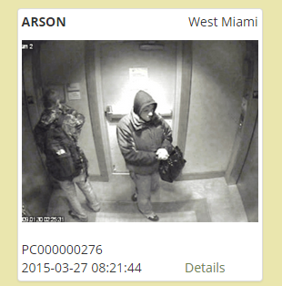
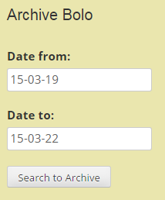
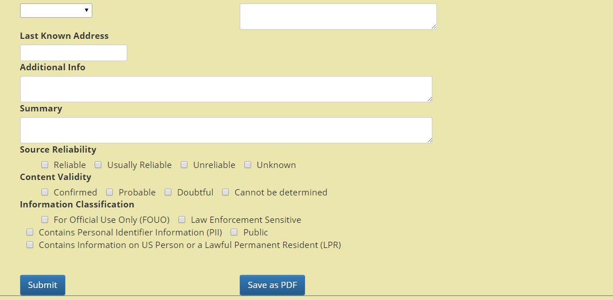
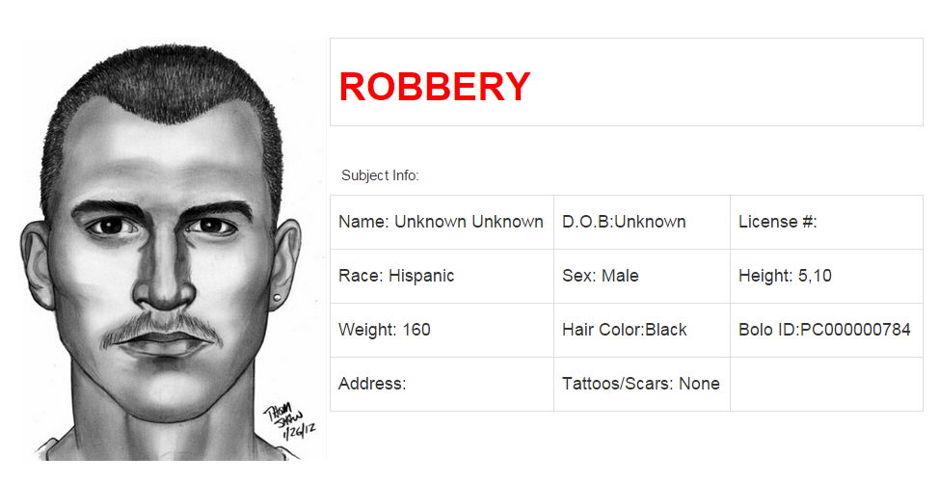
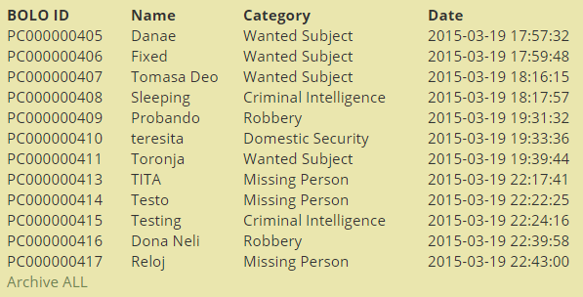
School of Computing & Information Sciences
Senior Project, 2015, Spring
BOLO Flyer Creator
Student: Danae I. Perez Tillan, Florida International University
Mentor: Major Jason Cohen, Pinecrest Police Department
Instructor: Masoud Sadjadi, Florida International University
Problem
Current System
Requirements
BOLOS, or Be On the Look Outs, is a law enforcement term that describes the way information is shared amongst police officers and between police agencies.
First responding police officer does not usually have the capability or time to create such flyer. Flyers are commonly created by detectives or analysts several days after the incident was reported. The distribution is via email so there is no central, searchable database. If you are not on the email distribution list, you don’t get the BOLO flyer.
A BOLO is distributed in several ways:
Over the police radio: When an incident occurs the responding officer will “BOLO” pertinent information over the police radio for other units to hear.
Via Computer Aided Dispatch (CAD) message: The officer will send a text only message via the CAD to other police units that are currently on duty.
A BOLO Flyer (Document) with pertinent information, to include pictures, is created, usually via MS WORD and then converted to PDF and distributed to other officers or agencies via Email or FAX.
BOLO Flyer Creator was designed to streamline this process and give the first responding officers the ability to quickly, from the field, create a BOLO flyer and distribute it via email and pdf to all users.
This can be done at the time the crime is reported.
This application not only distributes the flyer but posts it to a central site that is searchable.
All users have the ability to see via a graphical interface, all BOLOs posted as well as search the BOLOs by a variety of different criteria. BOLO flyer creator also give the user the ability to attach a video link should the video of the incident be available.
This solution allows all registered users, regardless of whether they were on duty or not the ability to view the flyers.
Using this application information is shared in as close to real time as possible as well as preserved via database for use and review at any time.
System Design
Implementation
The system implements a Server-Client architecture, with all the implementation being found within server side, where an Model-View-Controller architecture is used.
The front end of the website was implemented using HTML and JavaScript; and Bootstrap to make it mobile friendly, while PHP was used in the back end.
MySQL was selected as our Database Management System.
In order to create the pdf version of the BOLO the open source library mPDF was used.
Verification
Test Case ID | BOLO 007 PDF_SUNNY1
Purpose | To validate the Save as pdf functionality
Preconditions | Bolo Flier Creator is running. The user is login in the system. The user has clicked on Create Bolo in the navigation bar.
Input(s) | category = “WANTED” User clicks on Save as PDF
Expected Result | A flier for with the information entered in the form has been downloaded to the computer.
Result | PASS
Object Design
Summary
The BOLO Flyer Creator application provides a solution to give the first responding officers the ability to quickly, from the field:
Create a BOLO flyer and distribute it via email and pdf to all users.
Users can view all BOLOs posted as a flyer that included all suspect’s information.
Search the BOLOs by a variety of different criteria.
BOLO flyer creator also give the user the ability to attach a video link should the video of the incident be available.
Administrator can archive and delete a BOLO.
Test Case ID | BOLO 008 Search_SUNNY1
Purpose | To validate the data search result is correct
Preconditions | Bolo Flier Creator is running and has the bolo_creator DB loaded. The user is login in the system. The user is in the Search page.
Input(s) | Category= “ARSON” Agency= “West Miami”
Expected Result | The system was able to find the matching results using the criteria selected.
Result | PASS
Screenshots
Acknowledgement
The material presented in this poster is based upon the work supported by Major Jason Cohen and Pinecrest Police Department. I am thankful to the help that I received from my group member Icxe Vidal. I would also like to thank Masoud Sadjadi and Juan Caraballo for the feedback provided throughout the semester.

